Slide 1
Lecture 5 – Python(Strings)
By- Pratik Sanghvi

Slide 2
A string is a sequence
Like numbers we need a way to store alphanumeric sequence of characters
This problem can be solved by using string data type
A string is a sequence of characters with numbers and special symbols and is immutable in nature
We can say that like a value of a number cannot be changed, similarly the value of the string cannot be changed
We can only update the string by appending values to it and assigning to a new string
Eg: ‘Hello World 123’,’Hello Hello Mic check…’

Slide 3
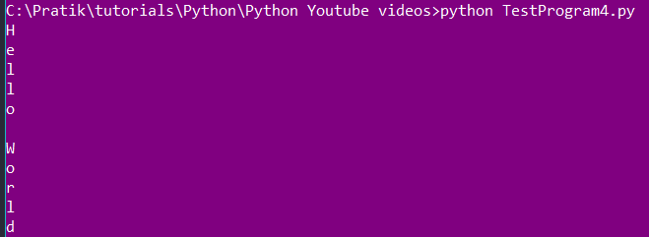
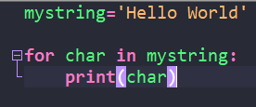
Traversal with a for loop
As we know that a string is a sequence of characters and we can iterate over it using a for loop.
Following is an example of a small program printing the characters of a string
Program
Output

Slide 4
String Slices
Given our prior knowledge that string is a sequence of characters, we can extract subset of characters together known as string slices
Eg: s = ‘Hello World’ → s[5:8]→’ Wo’
We can also use negative indexing on the string slices
Eg: s = ‘Hello World’ → s[-3:]→’rld’
General syntax for extracting string slice is as follows: string[n:m] where n is the starting index and m is the end index
The returned string is exclusive of the end index, meaning that the character at the end index will not be included in the output

Slide 5

Strings are immutable
The only reason why strings are immutable because they are supposed to be treated as concrete values like number
Also in order to trust external strings, they should remain unchanged
I came across one article for string immutability and it is quite good
String immutability
Fig: Example of invalid operation

Slide 6
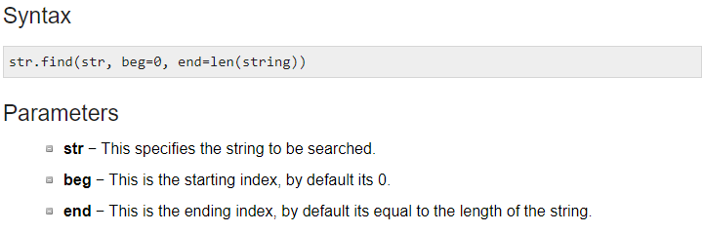
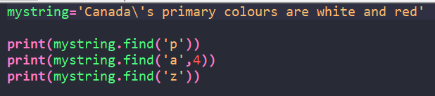

Searching
The operation of traversing a sequence and then finding where the character appears in the sequence is called searching
If we try to search a character and we could not find it then it will return -1
Fig: Syntax
Fig: Sample program
Fig: Sample program output

Slide 7
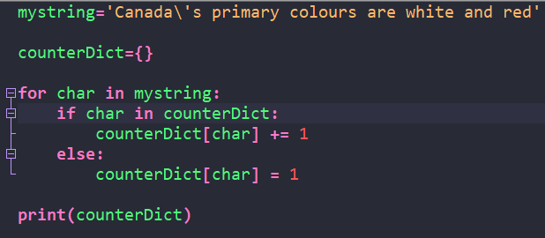
Looping and Counting
Looping and counting basically refers to iterating over the string characters and also counting the occurrences of the characters
Sample Program Output
Sample Program

Slide 8
String methods
Since we cannot change the value of the string, we have different methods to perform operations on the string
Eg: find(), upper() lower()
Sample invocation of the method is : ‘canada’.upper() → CANADA
Following link is a good reference for Python String methods: LINK

Slide 9
The in operator
In operator is basically used for checking the membership of a first value or object in the second value
Eg: ‘C’ in ‘Canada’ → True
The result of the membership operator is either True or False

Slide 10
String Comparison
Strings can be compared using the relational operators like less than, greater than and also equals
Eg: ‘apple’ > ‘banana’ →False
‘apple’ < ‘banana’ → True
‘apple’ == ‘banana’ → False
Note: We are able to compare the strings because there are numerical values associated to each characters. Also, the numeric value of upper case letters occurs before the numeric values of lower case letter

Slide 11
String operation
We can use the ‘+’ and ‘*’ operator on the string to perform string operations
Eg: ‘banana’ + ‘z’ → ‘bananaz’
Eg: ‘banana’ *2 → ‘bananabanana’
Using arithmetic operator on the string is known as string operations

